Slide 1
PROGRESSIO-(ALGORITHM AND WEBSITE )
By:Advika Yadav

Slide 2
ALGORITHM

Slide 3
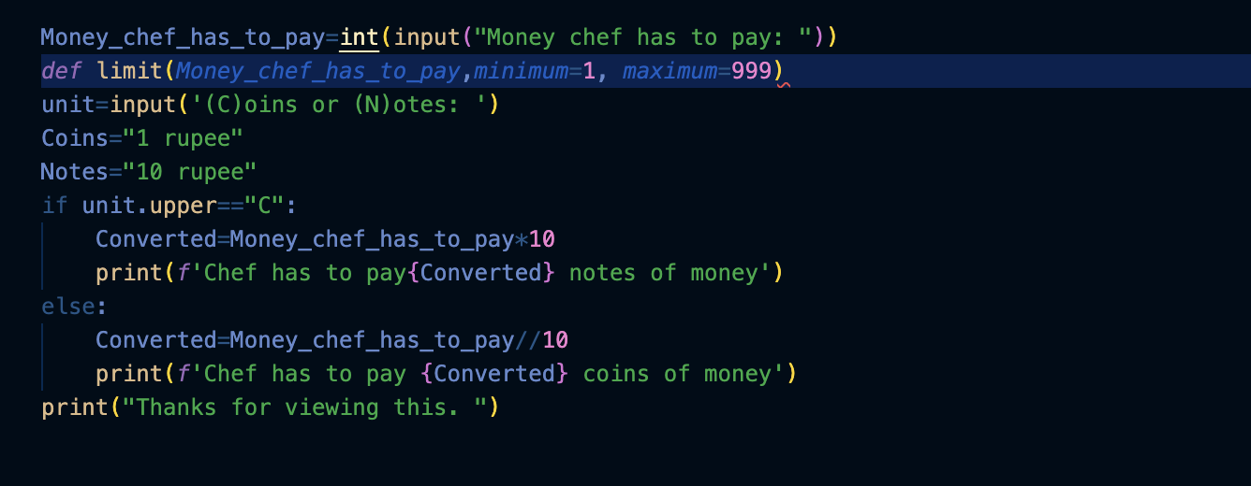
PROBLEM 1:
I used the if statement for doing some part of the code, and also used the def limit function to set the limit of 1-999.

Slide 4
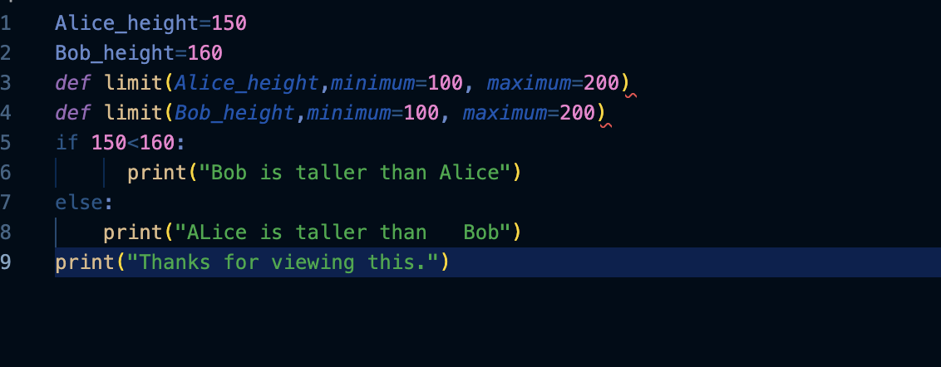
Problem2:
For this i also used the def limit function to set the range between 100-200.I have also used the if else statement to carry out this code.

Slide 5
WEBSITE

Slide 6
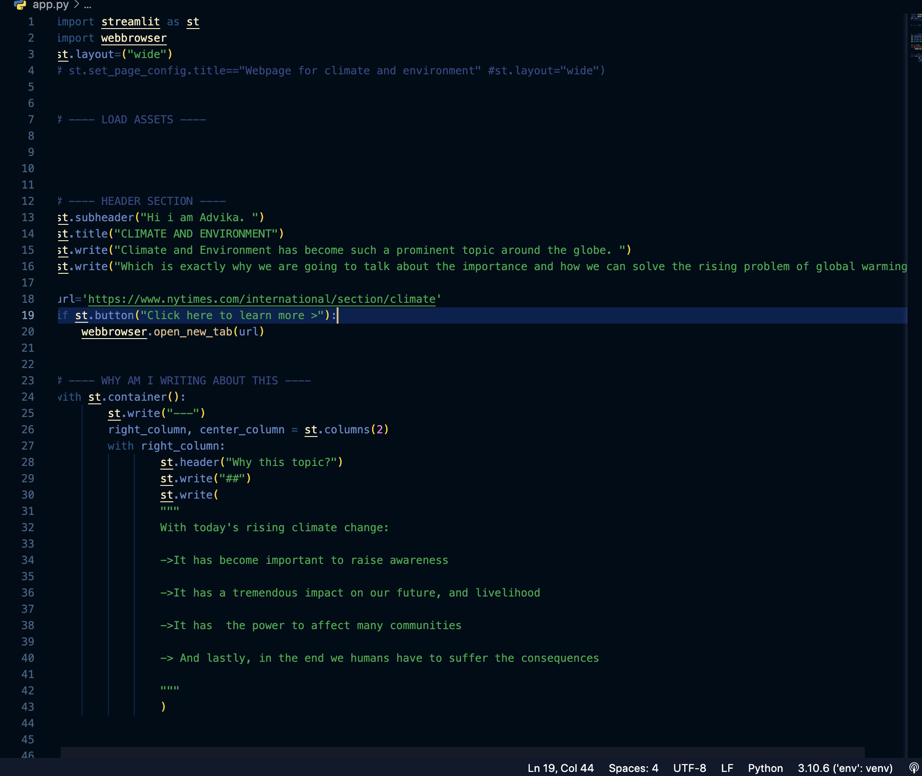
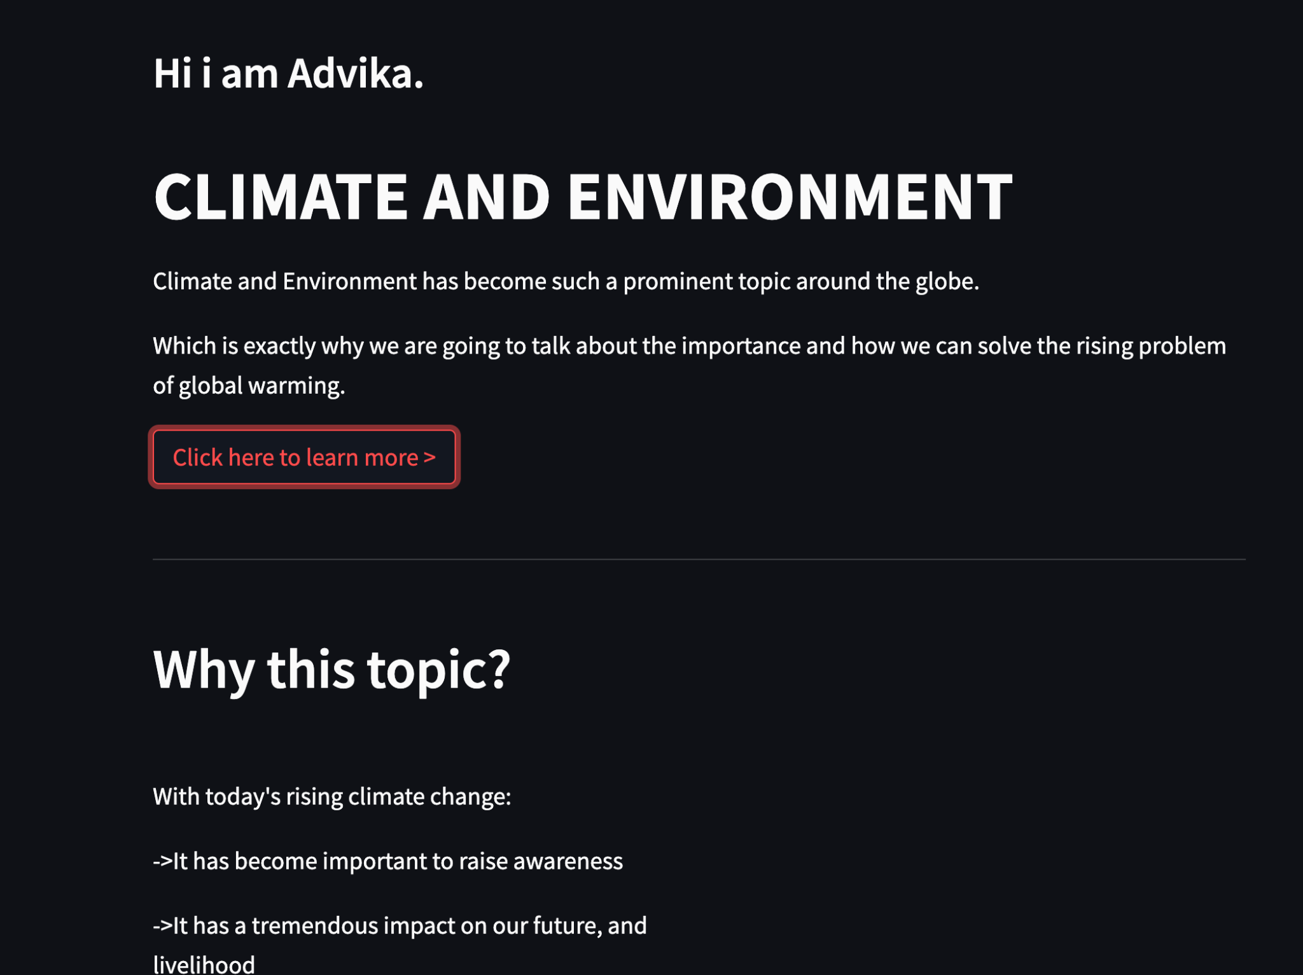
WEBSITE FOR CLIMATE AND ENVIRONMENT
INPUT
OUTPUT

Slide 7
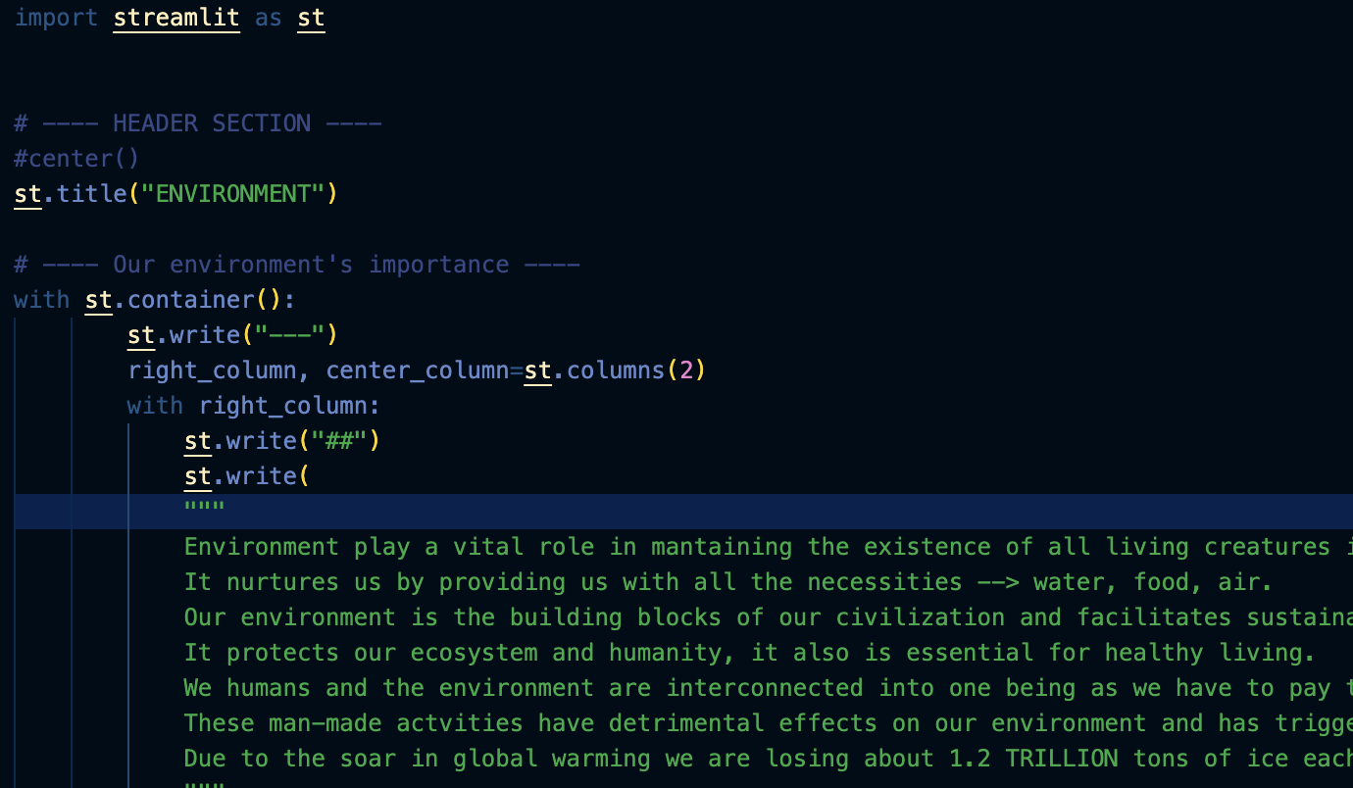
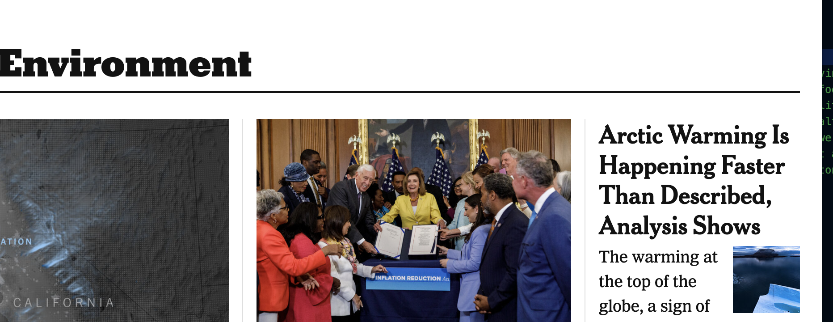
WEBSITE FOR CLIMATE AND ENVIRONMENT
INPUT
OUTPUT

Slide 8
THANK YOU

